Slide 1
November 14th 2019
Collaboration for Civil 3D
Zach Graff, P.E.
Notes:
Hello and Welcome. My name is Zach Graff—I’m an engineer with CAD Masters where I’ve worked for the last 10 years implementing, customizing, and training Autodesk software for the AEC industry. Today I’m going to spend some time talking about and showing you BIM 360 as it applies specifically to the world of Civil Design. I’ll take some time to give some background info, then show you the basics of BIM 360 Docs and the new Civil Specific features of BIM 360 Design.

Slide 2
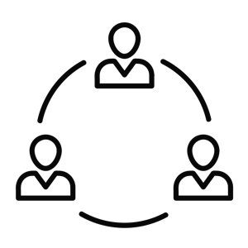
Industry Trends
Urbanization
BIM Mandates
Distributed Project Teams
Notes:
Recently, the increase in BIM (Building Information Modeling) has seen an explosion in the tools building designers can use to create data rich models of their designs, visualize them, and share them with distributed project teams easily and securely. The tools available for Civil Designers have slowly followed suit. Of course, we have Civil 3D for the bulk of our work, but also Infraworks for early stage planning and visualization, and 3DS Max Design for compelling still images and animations. Now with the release of BIM 360 Design Collaboration for Civil – we’ve finally got that last piece—a full seat at the BIM 360 table.

Slide 3
Industry Reaction
Designer | Engineer | Contractor | Owner
DESIRED EXECUTION
Data Continuity
TRADITIONAL EXECUTION
Transmit
Transmit
Transmit
Notes:
We’ve got a larger industry that is moving toward multi-discipline collaboration, and dispersed project teams. Stakeholders increasingly want access to the project at all times and they want a smooth handoff process and the project moves from design, through construction, and into operation. There is more and more data being created throughout this process and BIM 360 helps to package it all together in one location—available and traceable at the end of the project, with smoother handovers along the way.

Slide 4
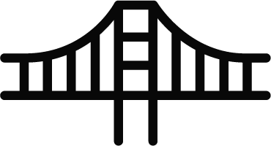
Top Collaboration Challenges
Security &
Accountability
Team Communication
Project Complexity
Inefficient Tools
Notes:
Now let’s talk about some of the collaboration challenges you’re facing.

Slide 5
Top Collaboration Challenges
Security &
Accountability
Team Communication
Project Complexity
Inefficient Tools
Notes:
First, the issue of Security and Accountability. Are you concerned about who has access to your files? Can you easily control that? Are you aware of who’s doing what in the project? Can you tell when files were created, updated, by who, and what changed?

Slide 6
Top Collaboration Challenges
Security &
Accountability
Team Communication
Project Complexity
Inefficient Tools
Notes:
When it comes to team communication, are you frustrated working with other teams because you feel your design intent is getting lost in translation before the project even begins?

Slide 7
Top Collaboration Challenges
Security &
Accountability
Team Communication
Project Complexity
Inefficient Tools
Notes:
Another concern is Project complexity. Projects are getting more complex and schedules are getting tighter. When these factors aren’t addressed up front, there are negative impacts on the overall quality of the project. Short term solutions may end up with long term consequences.

Slide 8
Top Collaboration Challenges
Security &
Accountability
Team Communication
Project Complexity
Inefficient Tools
Notes:
The last challenge centers on technology itself. Most tools are not purpose-built to handle AEC design Data—and especially not Civil Design data. Have you been using tools, that make collaboration difficult? Where the history of a project is lost, and where the current version of the project has to be hunted down over and over again?

Slide 9
What If You Could?
Notes:
What if you could solve all of these challenges?

Slide 10
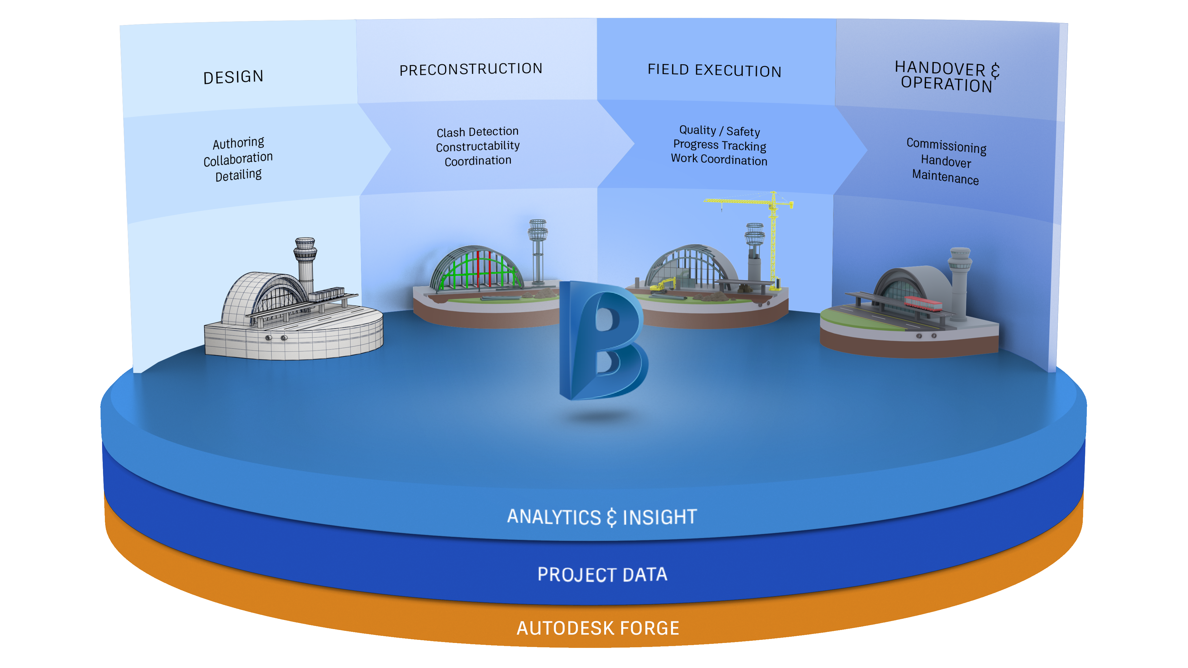
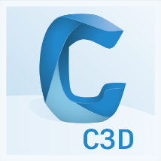
BIM 360: A Connected Platform
Notes:
Enter the BIM 360 platform. Autodesk brought everything together into a single BIM 360 brand that supports Design, Build & Operate. BIM 360 aggregates and unifies all project data into one single source of truth. Providing real time access to the current model for all stakeholders while allowing collaboration, transparency and accountability.

Slide 11
BIM 360 Platform
Notes:
So, now we’ll take a look at BIM 360 Design built for collaboration by engineers, architects, and all project stakeholders.

Slide 12
Top Collaboration Challenges
Security &
Accountability
Team Communication
Project Complexity
Inefficient Tools
Notes:
So just a quick reminder of our challenges, so we can see how BIM 360 Design addresses them.

Slide 13
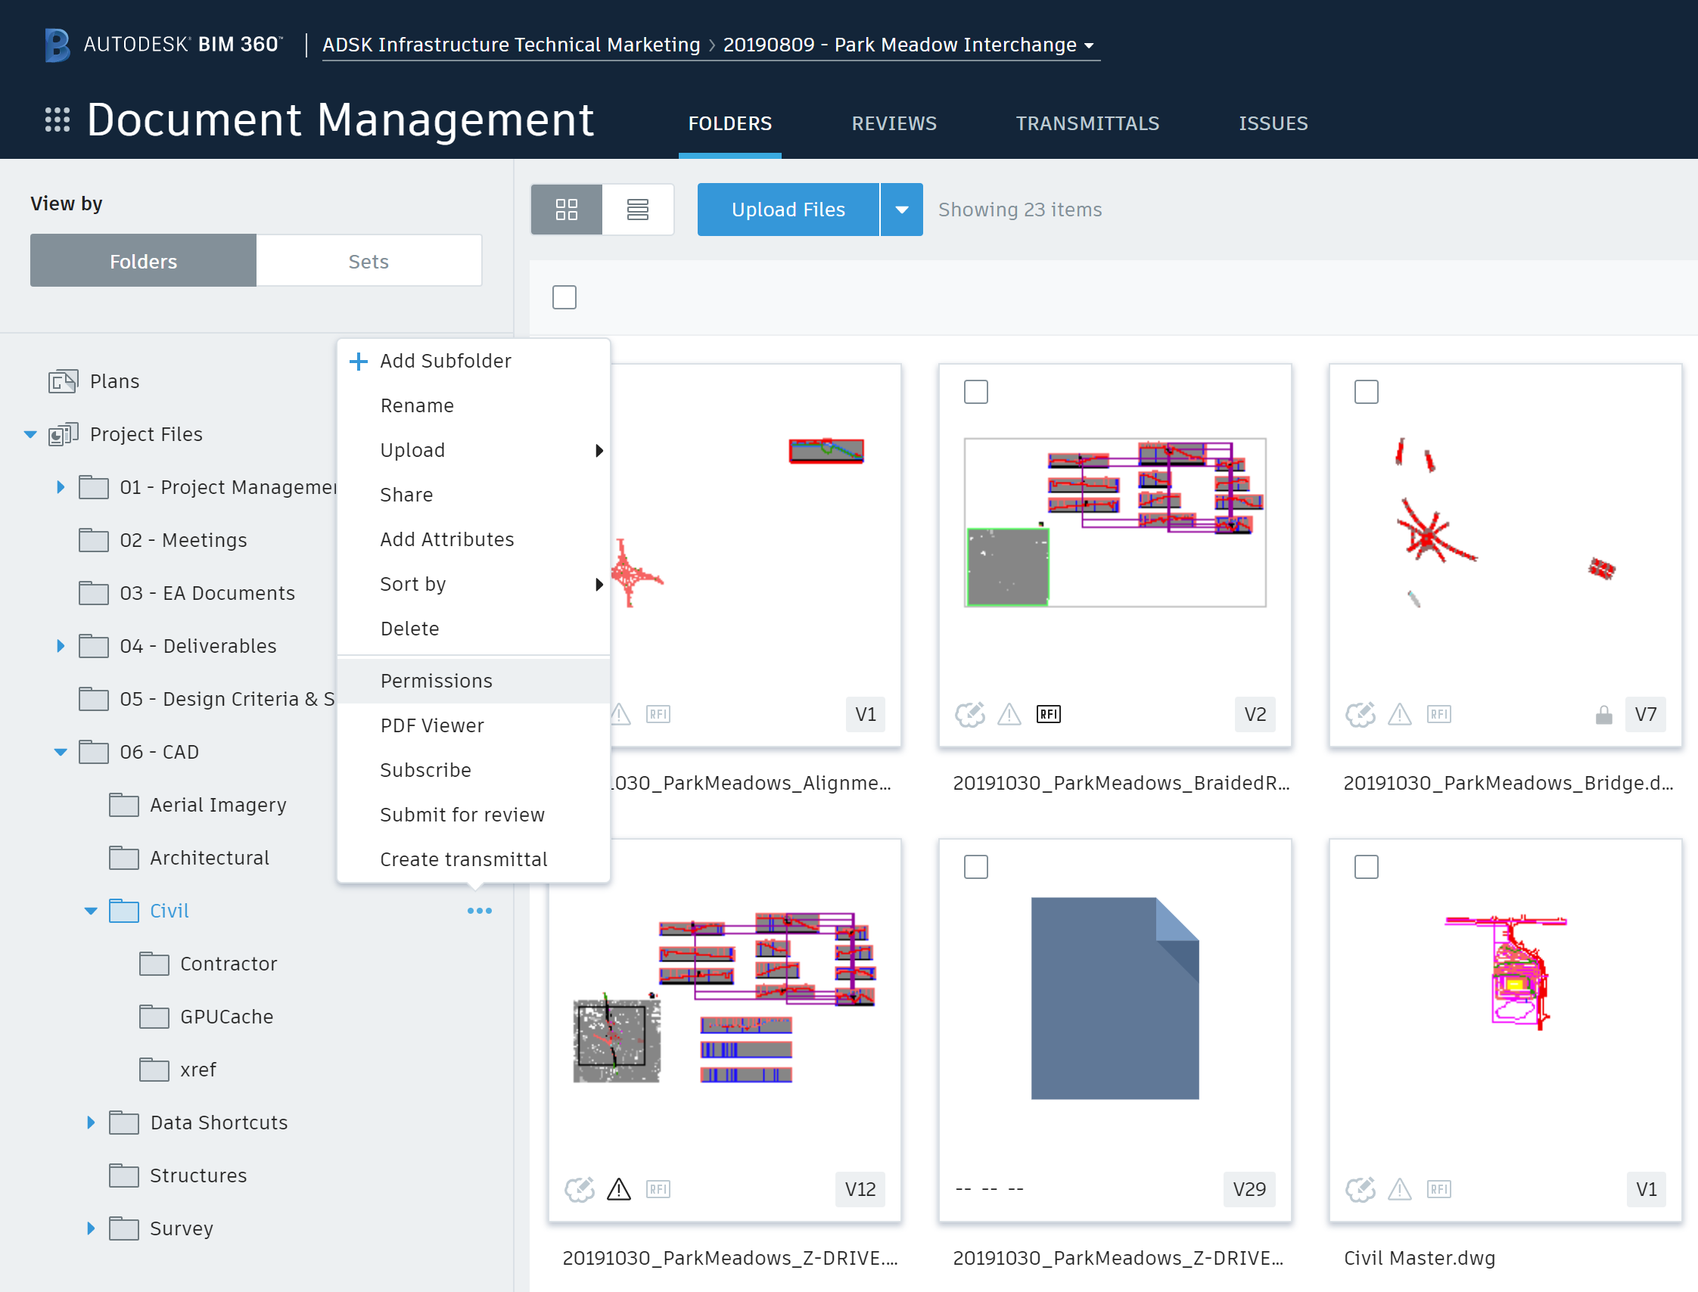
Security: Folder-Level Permissions
Multiple permission & access levels
Restrict folders by role or company
Control access by user
Control work sharing and design deliverable exchange with the assurance that the right information is in the right hands throughout the project.
Notes:
With BIM 360 you restrict access to folders based on user, role or company. Multiple access levels allow you to assign the correct level of access for the situation. Give each company their own private folder, group collaboration folders, give project managers access to all files—with the right combination you have flexibility to easily control who sees what, and what they can do with it.

Slide 14
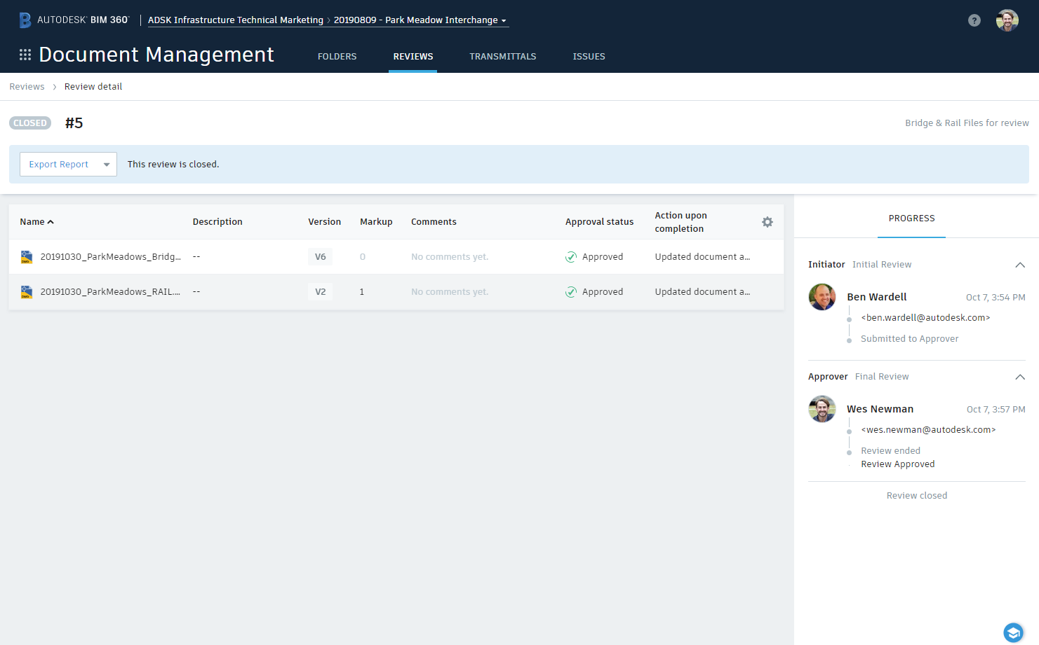
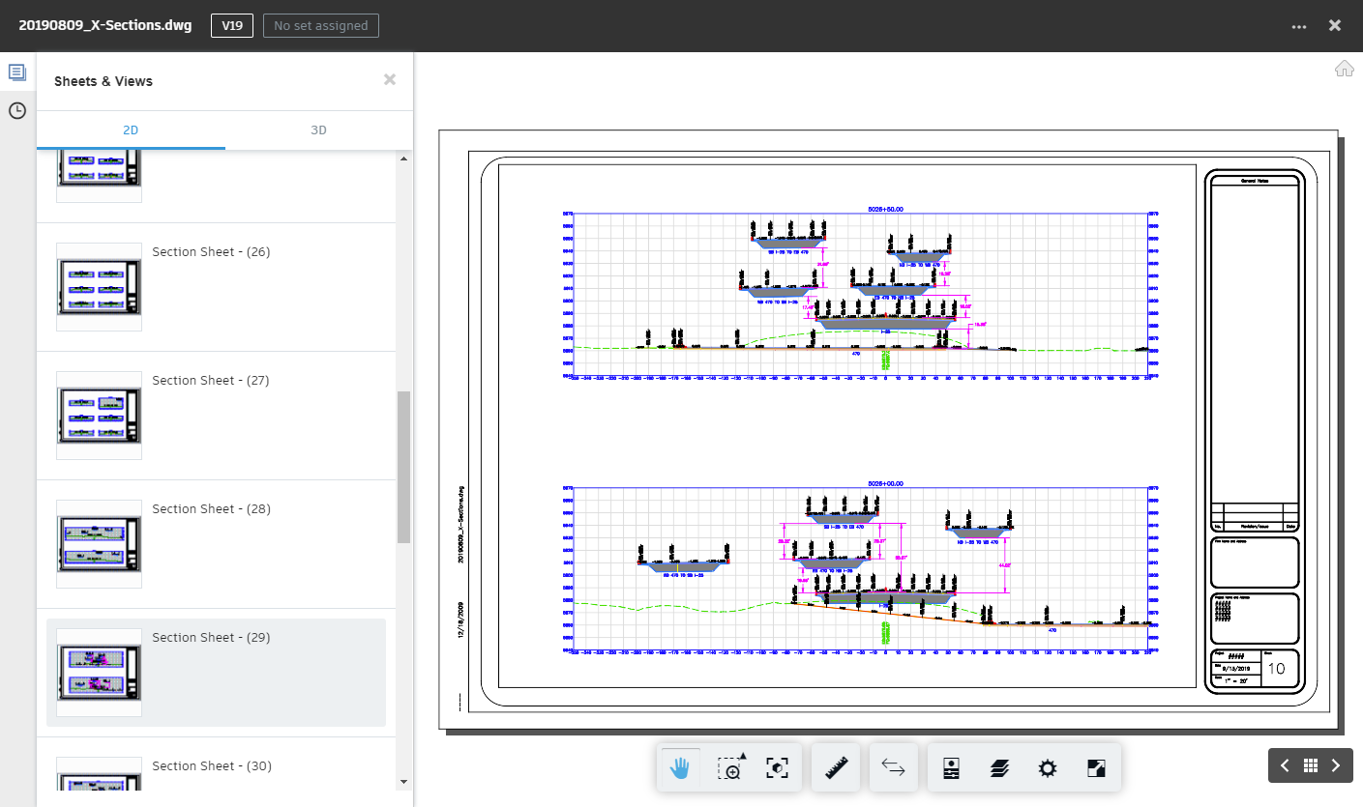
Team Communication: Transmittal Coordination
Manage transmittals and create review packages.
Track and review the status of transmittals.
Distribute and control reviewer privilege
Ensure that your project team is always aware of the project’s overall progress.
Notes:
Team communication can be made more efficient – it’s easy to ensure that your project team is always aware of the projects overall progress.
Create and manage transmittals to package up design documents at key stages in the project. It’s easy to go back and look at the transmittals throughout the life of the projects to see the correct version of each file included.
Create review packages to manage the approval process. Design the review with as many steps and people as you need to move files through the process you already use.
For both transmittals and reviews, track who did what and when for every instance, throughout the entire project.
Ensure that everyone meets their milestones and deadlines and reduce the time it takes to effectively review design revisions.

Slide 15
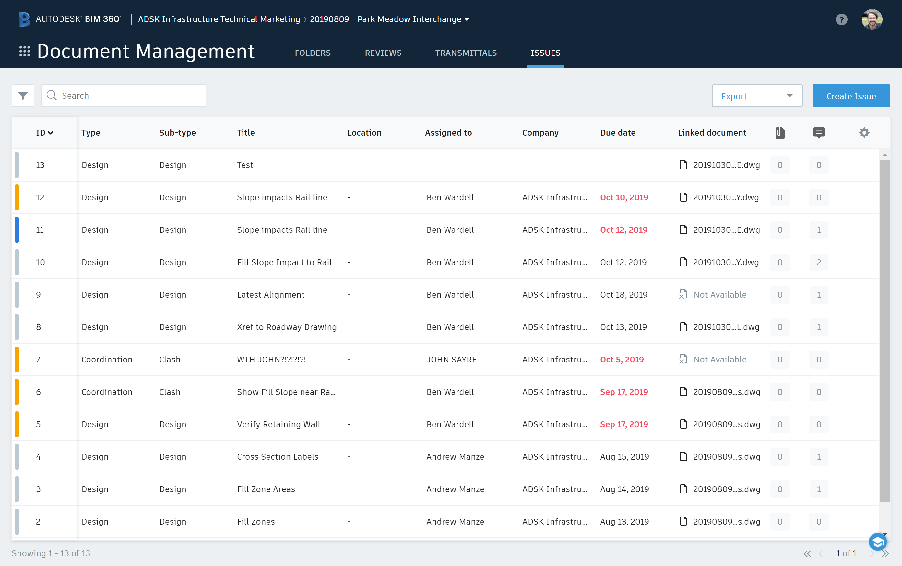
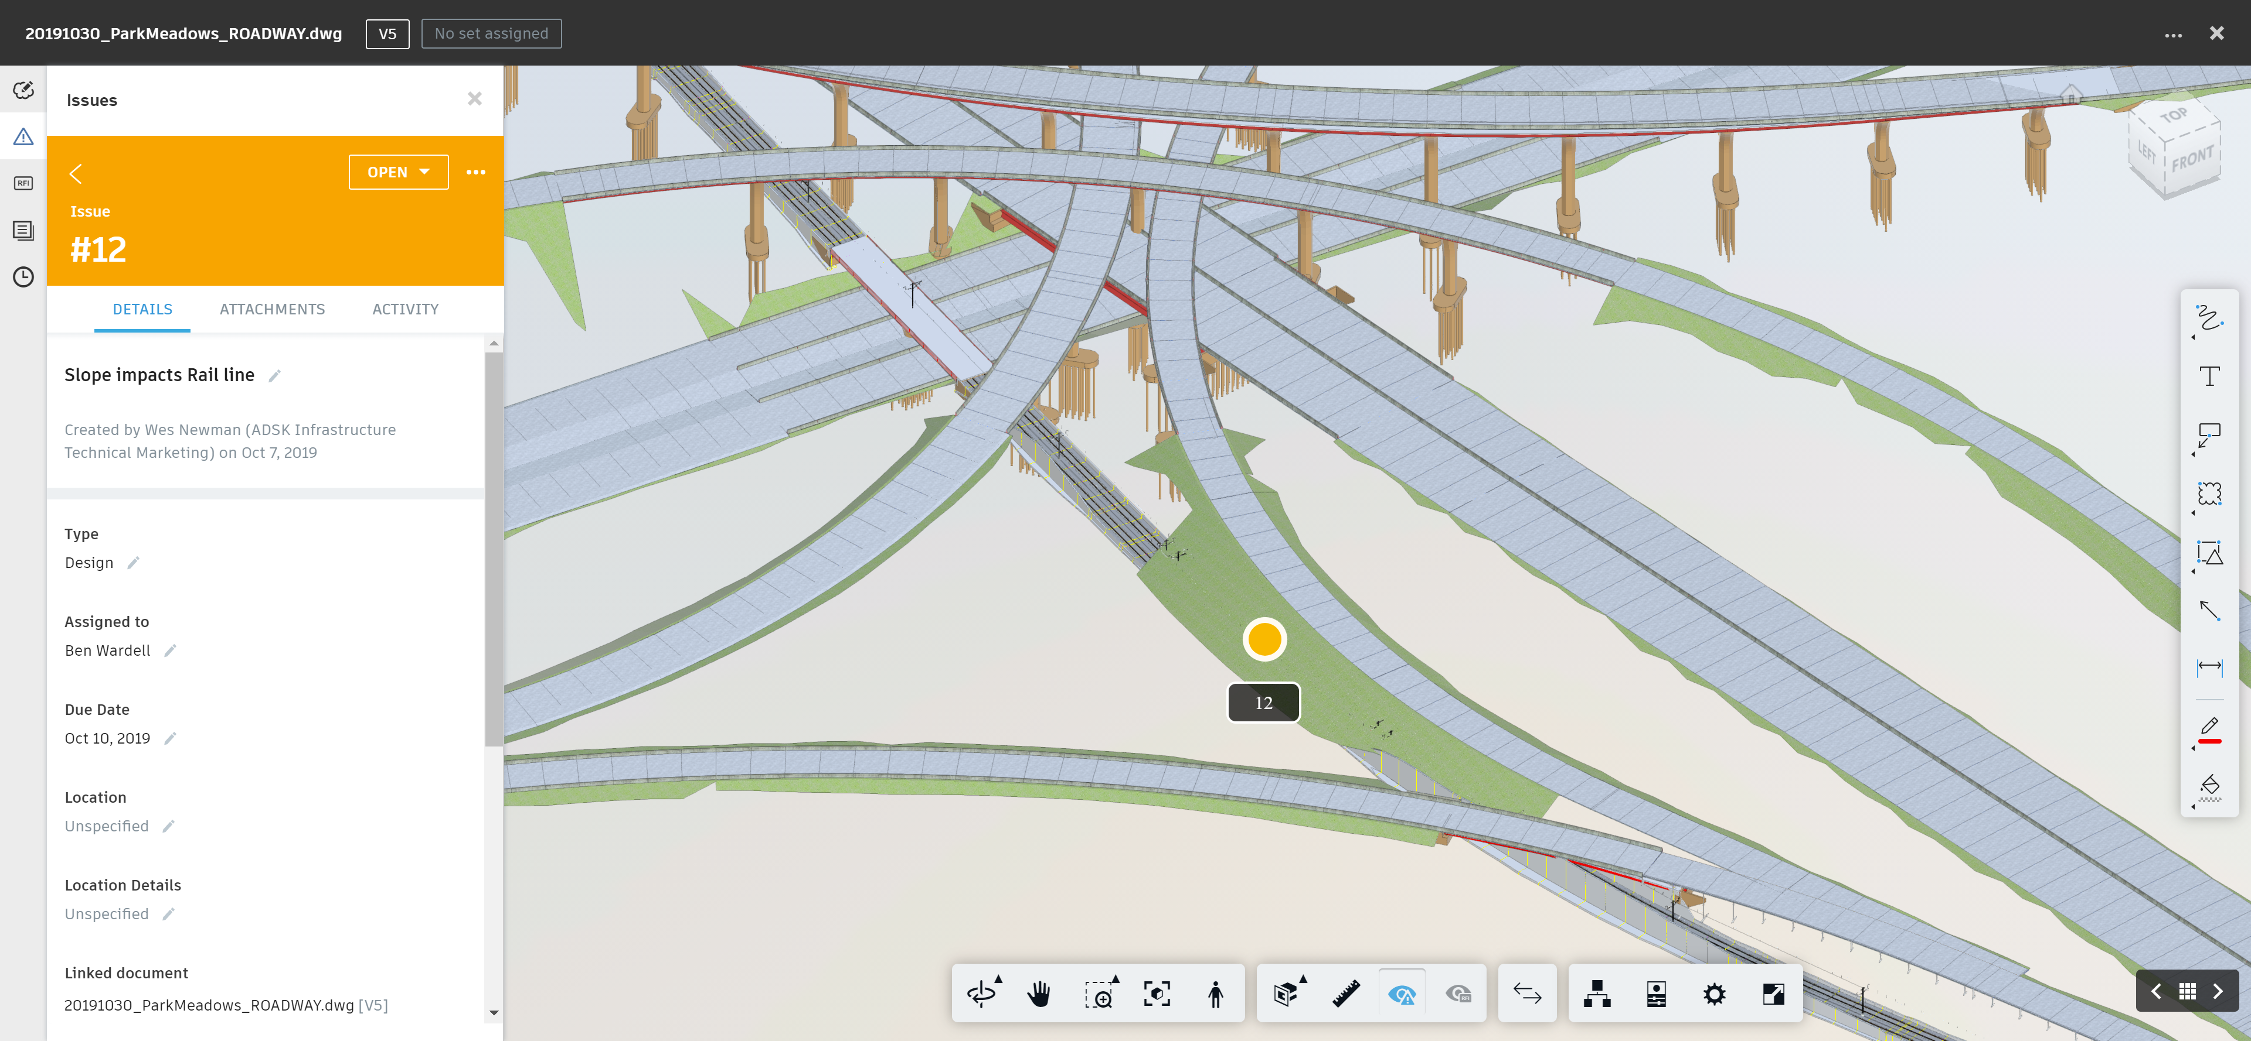
Accountability: Issue Tracking
Assign work to members
Set Locations
Track resolution status
Identify issues in the context of designs, assign work, and track issue resolution through inspection and completion.
Notes:
Hold your project team accountable by ensuring that everyone in the project is completing their tasks in a timely manner by using issues. Use BIM 360’s issue tracking and management tool to put context around issue resolution with the ability to pin an issue to any 2D or 3D design location, collaborate with comment threads, add photos, assign work and track resolution through inspection.

Slide 16
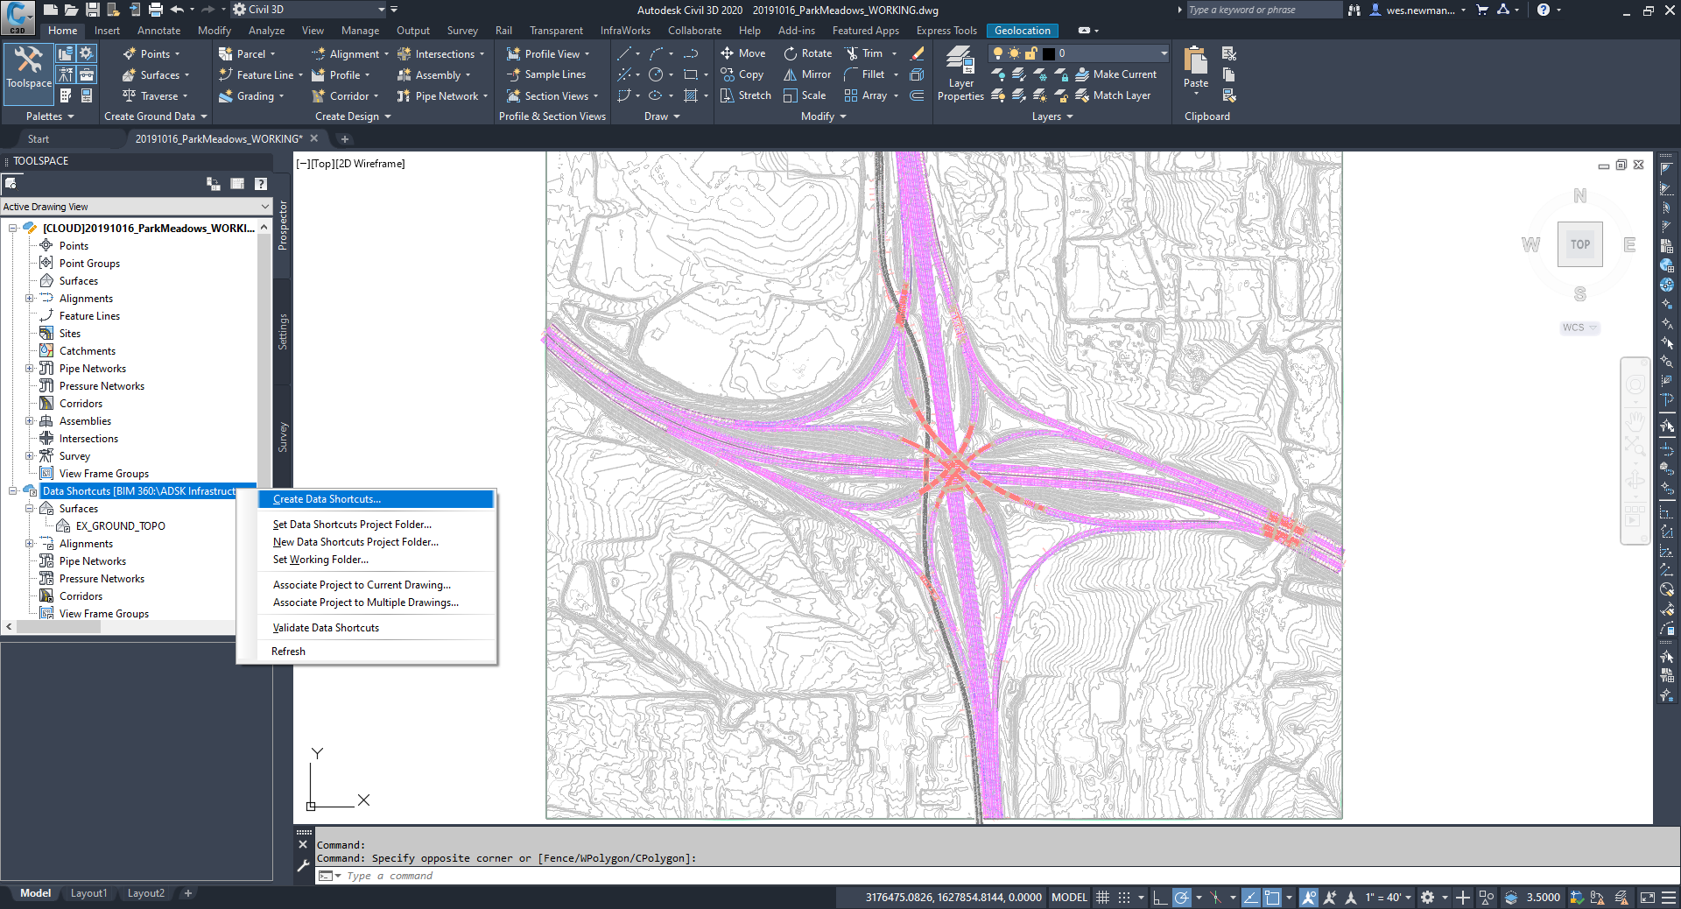
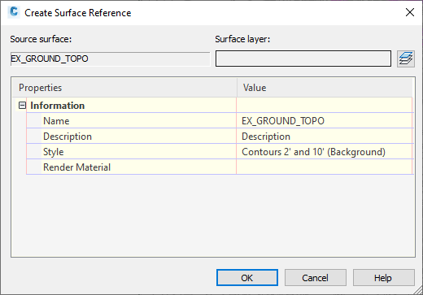
Needs to talk about C4C3D value
Project Complexity: Collaboration for Civil 3D
Cloud based Civil 3D project management
Extend design data to external stakeholders
Better allocate design resources
Connects project teams with centralized access to Civil 3D project data in the cloud, with no need for costly IT setup.
Notes:
If your concern is alleviating complex projects by enabling members to better collaborate on designs, you can use BIM 360 Design to enable anytime, anywhere access to Civil 3D projects. With this ability, you can extend file collaboration to project teams in any location, while centralizing efforts of distributed teams. You can also better allocate resources and assign the best team members with the most relevant skill sets to each project.

Slide 17
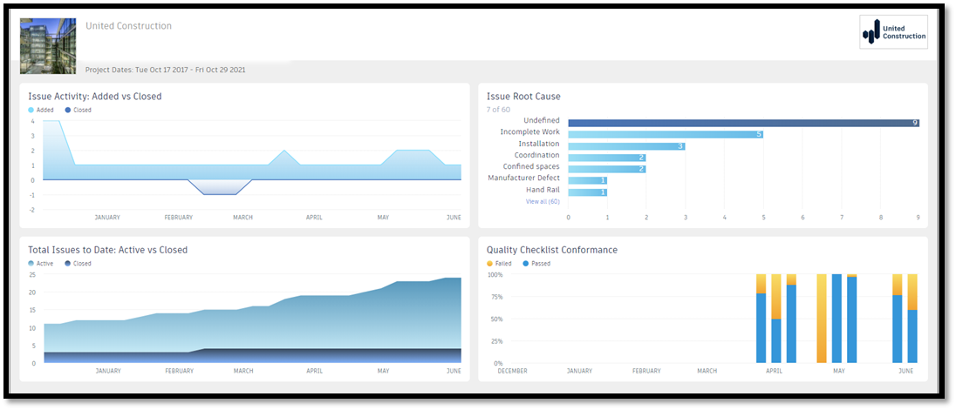
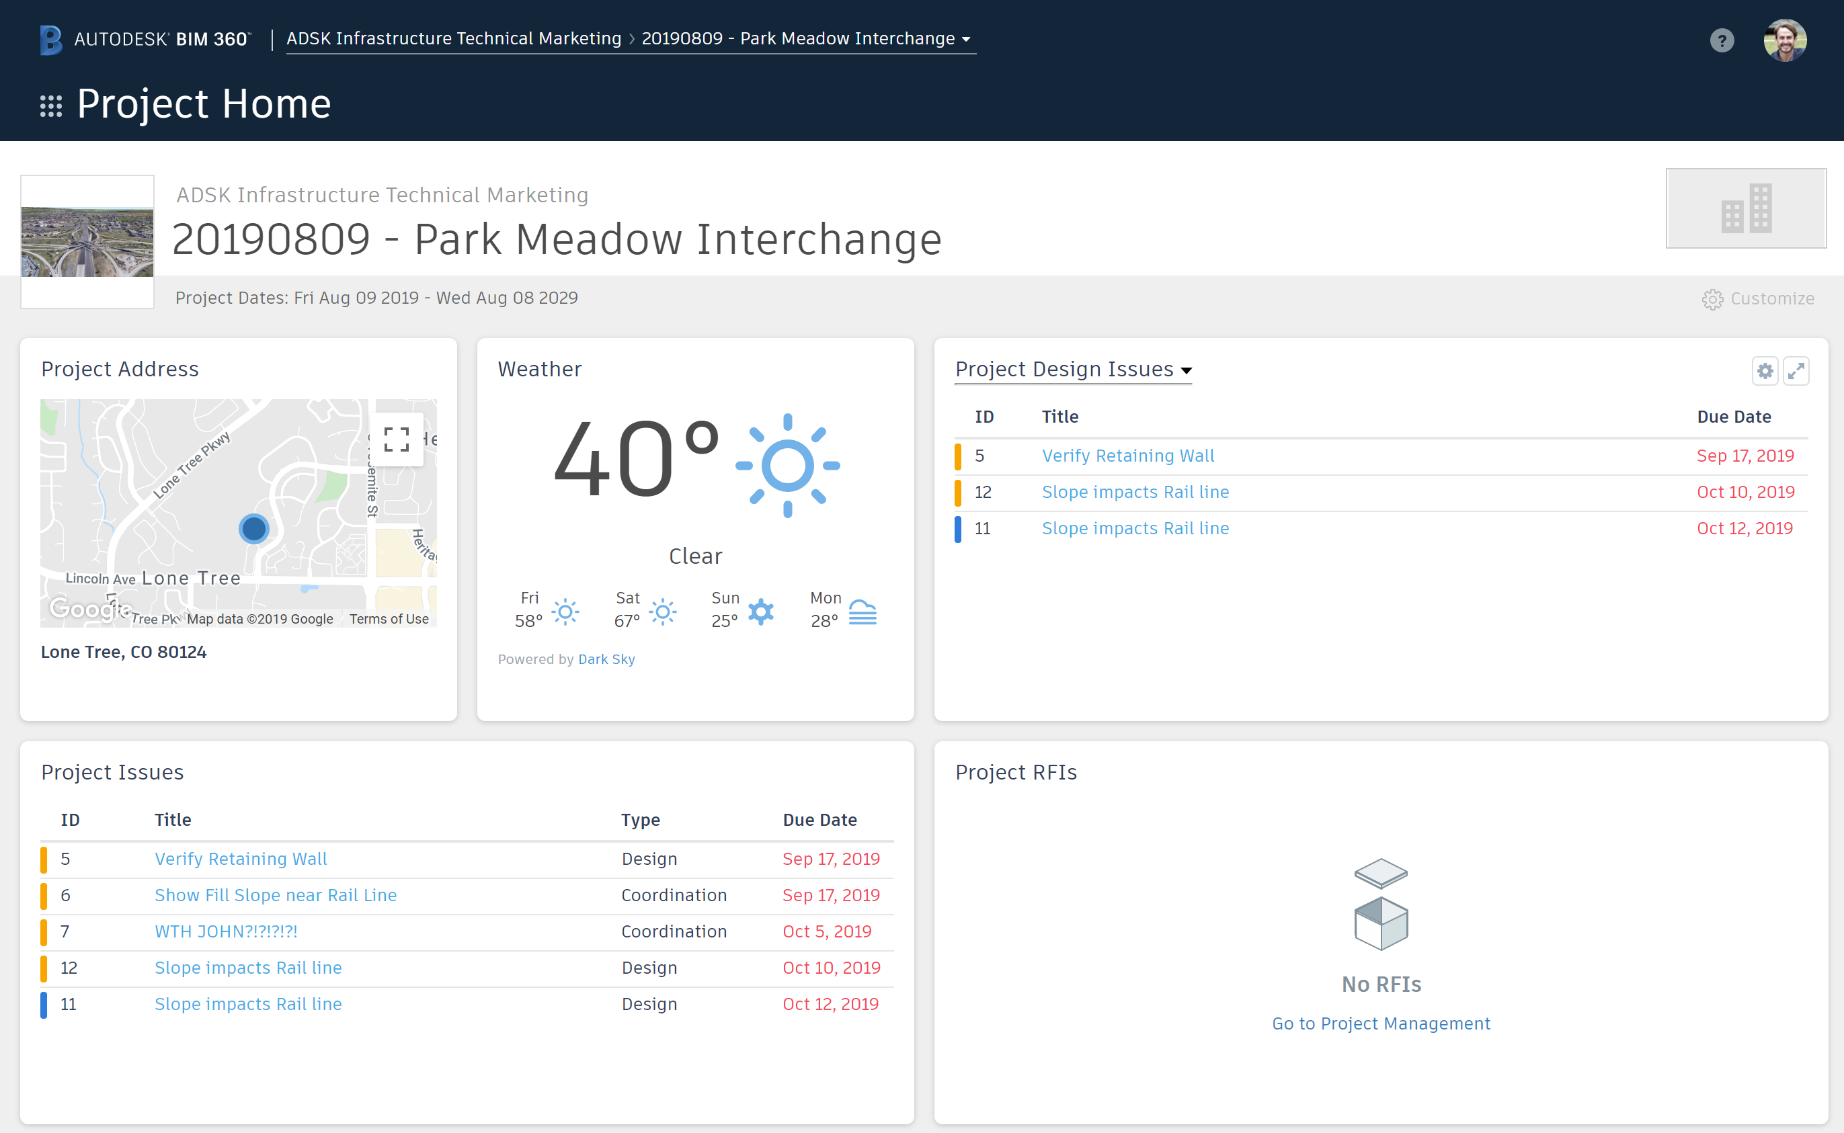
Inefficient Tools: Analytics & Insight
Track Design Packages
Monitor Issues
Address RFIs
Project Home provides a unified view into important, relevant, and actionable information from across BIM 360 to our users.
Notes:
If your concern is having access to a tool that is purpose built for AEC Design projects and provides useful BIM data, Project Home provides a unified view into important, relevant, and actionable information from across BIM 360 to users. This allows you to quickly evaluate areas that require attention for you or your team. From Project Home, you can easily navigate to other BIM 360 modules to continue your work. This is a part of our efforts to make the BIM 360 experience more unified, simple, and data centric for our customers.

Slide 18
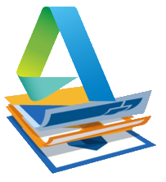
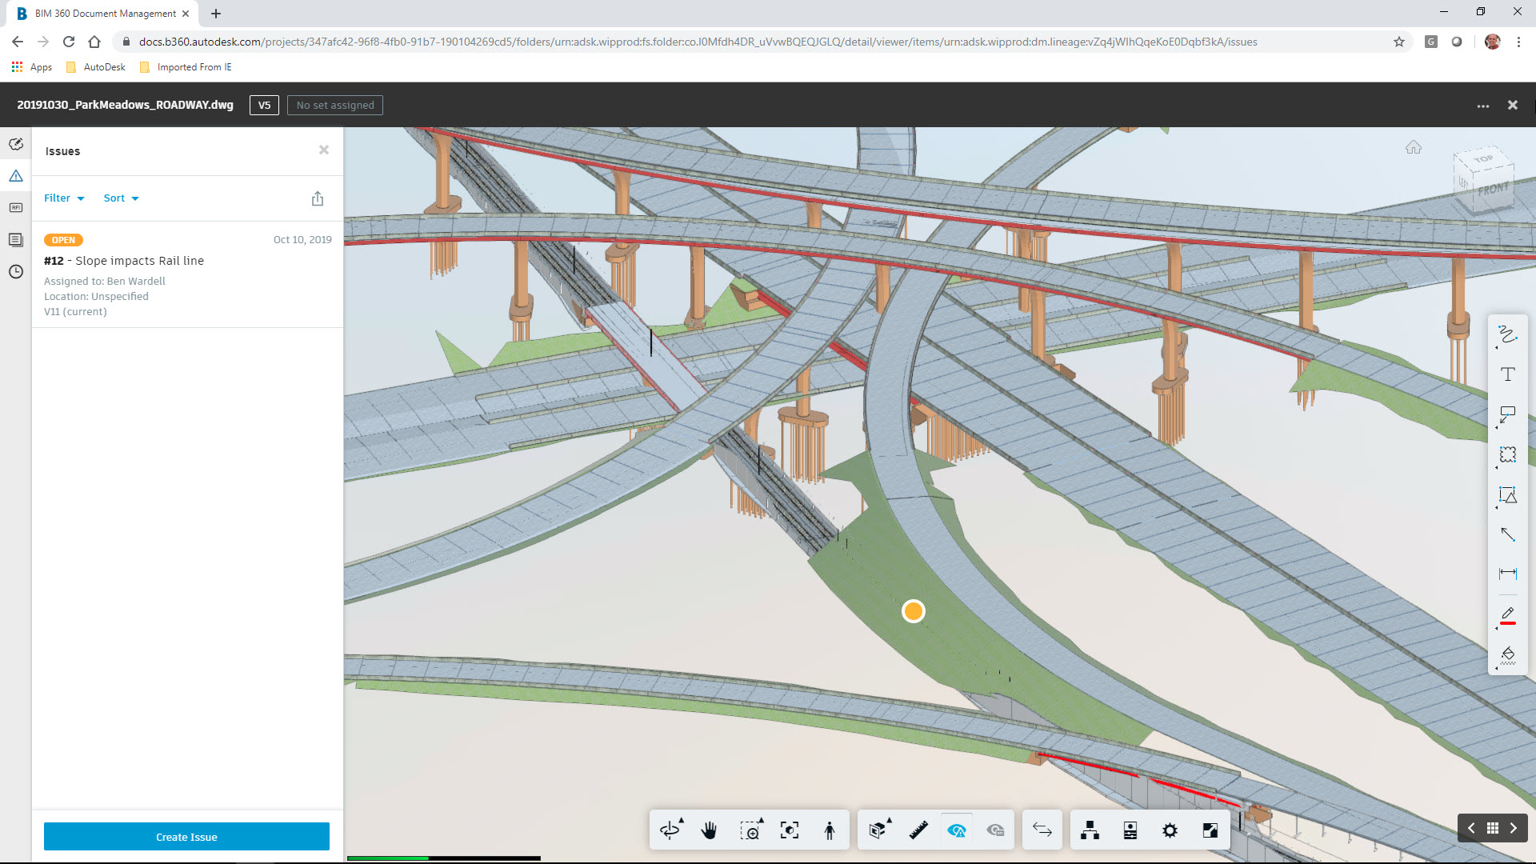
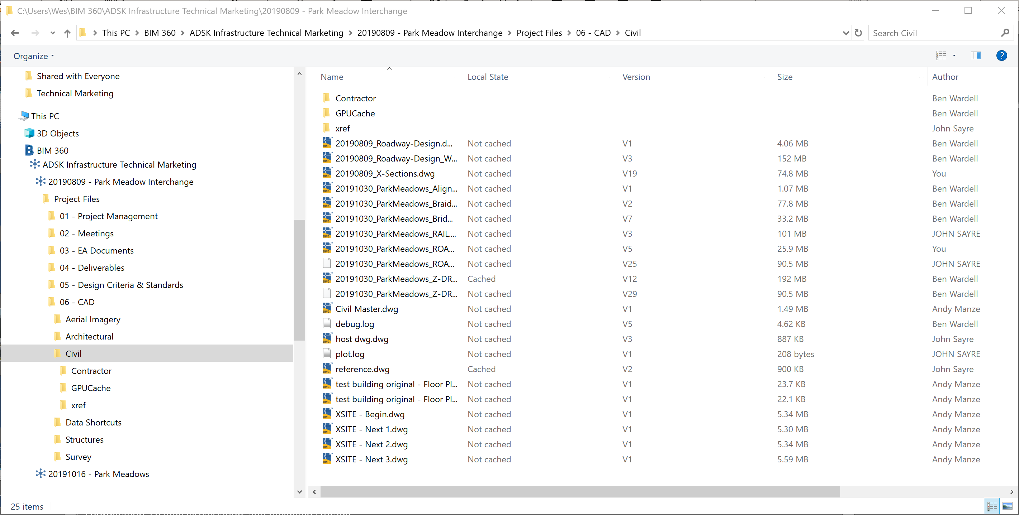
BIM 360 Design for Civil 3D
Collaboration for Civil 3D
Document Management
Desktop Connector
BIM 360 Docs
Civil 3D projects managed in the cloud
Create and Consume Data Shortcuts
Automated file locking
Review Submittals
Visual Version Control
Issue and Mark-up creation
BIM 360 access on the desktop
Lock and unlock files
View file status (Version, Author, etc..)
Notes:
BIM 360 Design for Civil 3D allows civil infrastructure professionals and extended project team stakeholders, whether within one firm or across multiple firms, to collaborate securely and store data on the BIM 360 platform for AEC projects.
BIM 360 Design for Civil 3D includes 3 key items:
Collaboration for Civil 3D
The Document Management module on the BIM 360 platform
and Desktop Connector
With BIM 360 Design’s Collaboration for Civil 3D, you can access your BIM 360 drawings directly from the Civil 3D start menu. Collaboration for Civil 3D also allows users to store and consume xrefs from the cloud and create and manage data references such as surfaces, alignments and corridors. As team members open or create files, Automated File Locking ensures data integrity by keeping other users out.

Slide 19
Benefits
Single source of truth
Controlled Civil 3D file access across teams
Faster, more efficient collaboration
Reduce internal server and IT costs
Deliverable coordination
Reduce re-work with trackable project activity and file version history
Perform design review with stakeholders
Access your project data anytime, anywhere
Notes:
You get faster, more efficient Civil 3D collaboration. You have anytime access to Civil 3D models—from anywhere in the world, which can give you access to more projects—extend your reach to locations outside your physical address. You can better allocate team talent and resources by putting team members with the best skillset in an area on that part of the project. Finally, you can include everyone—partners or consultants who don’t use Civil 3D still have a real time view of models for faster communication and better buy in.

Slide 20
Start collaborating today
+
Autodesk BIM 360 Docs
Autodesk BIM 360 Design
for all project stakeholders who need the ability to collaborate with the entire team to find, view, comment on, and approve project data
for engineers, contractors and extended project team stakeholders who need to securely collaborate in real-time on Civil 3D projects and coordinate deliverables
Notes:
So, start collaborating today. Use BIM 360 Design for team members that will actively work in Civil 3D (or Revit) and BIM 360 Docs for team members that wont but still want to see the current model and participate in reviews and communication.

Slide 21
Questions?
Zach Graff, P.E.
zach@cadmasters.com
Notes:
To summarize, Autodesk offers two unique tools that work together to improve design collaboration.
For AEC Design Teams who need to access design data to review, markup, and interact with designs, we offer BIM 360 Doc. It provides centralized project design information makes it easily accessible to extended team members.
For designers who leverage Civil 3D, we offer BIM 360 Design. Built on top of BIM 360 Docs, BIM 360 Design enables civil design teams to work in a connected environment regardless of user location.

